Slide 1

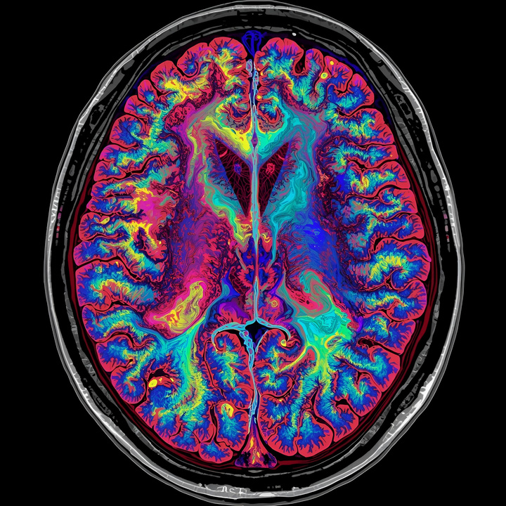
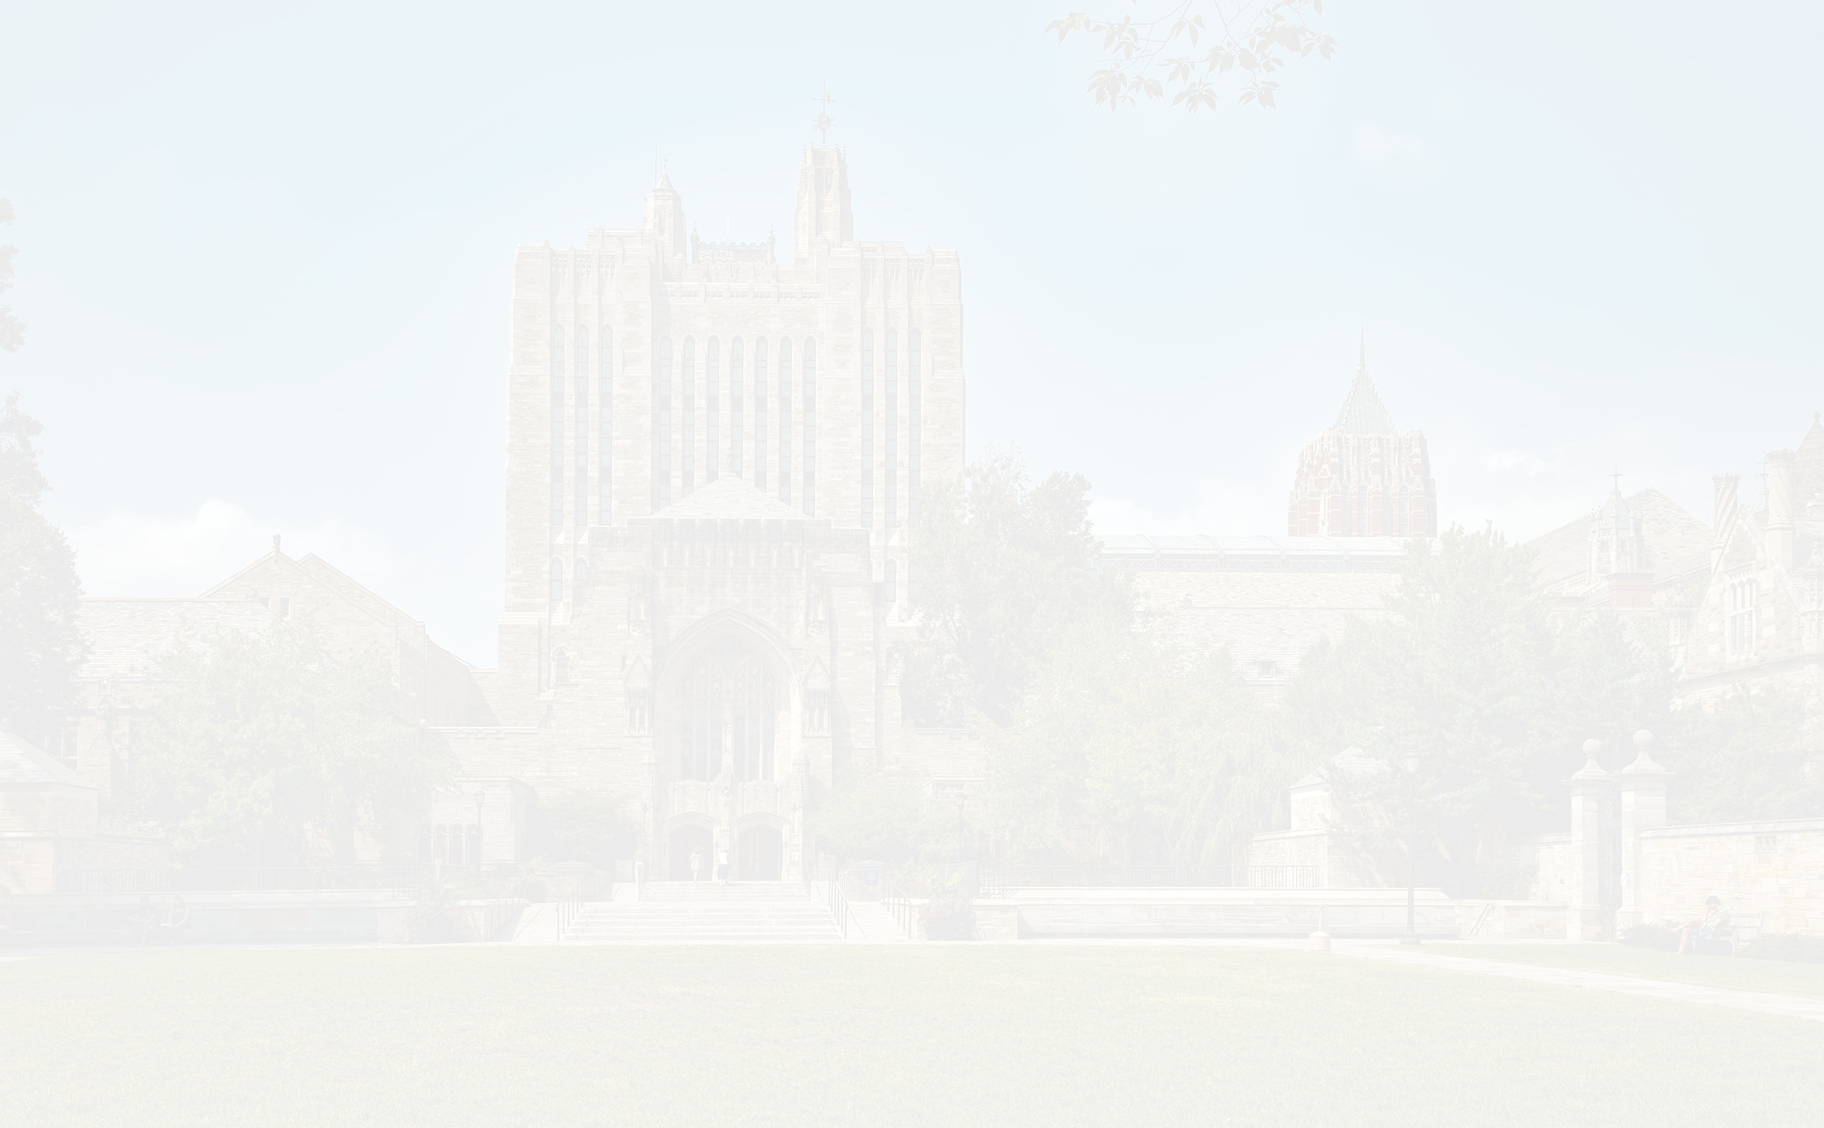
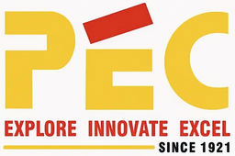


PUNJAB ENGINEERING COLLEGE, CHANDIGARH
PROJECT PRESENTATION
MULTIMODAL MEDICAL IMAGE FUSION
USING DEEP LEARNING
BY: GURNOOR KAUR (23103112)
SHIVIN GOYAL (23103129)
SHAHBAAZ SINGH (23103074)
SAHIL SARNA (23103099)
MENTORS: DR. SUDESH RANI &
DR. PADMAVATI

Slide 2



Table Of Content
Problem Statement
Limitations in current scenario
Benefits of fusion
Dataset DIstribution
Architecture and Flowchart
Innovation and Metrics
Conclusion
Refrences

Slide 3



Overview & problem statement
In medical diagnosis, different imaging modalities (CT, MRI, PET, SPECT) capture complementary but incomplete information.
CT provides high-resolution anatomical details, while MRI highlights soft tissues, but no single modality gives a full diagnostic view.
Clinicians currently need to mentally integrate multiple scans, which is:
Time-consuming and cognitively demanding.
Prone to interpretation errors and diagnostic uncertainty.
Traditional fusion methods (e.g., PCA, DWT, NSCT):
Depend on manual feature extraction.
Often lose important texture or edge information.

Slide 4

Limitations in Current Medical Imaging
CT: Excellent for bone and structural details but lacks soft-tissue contrast.
MRI: Captures soft tissue contrast but limited in spatial precision.
Challenge: No single modality offers a complete diagnostic picture.
Traditional fusion (PCA, DWT, NSCT): Lose fine details, require manual tuning.

Slide 5


Benefits of Medical Image Fusion
Combines complementary data for enhanced diagnostic clarity.
Improves lesion visibility, tumor localization, and surgical planning.
Reduces diagnostic uncertainty and reliance on manual interpretation.
Creates an integrated visual aid for radiologists and surgeons.

Slide 6

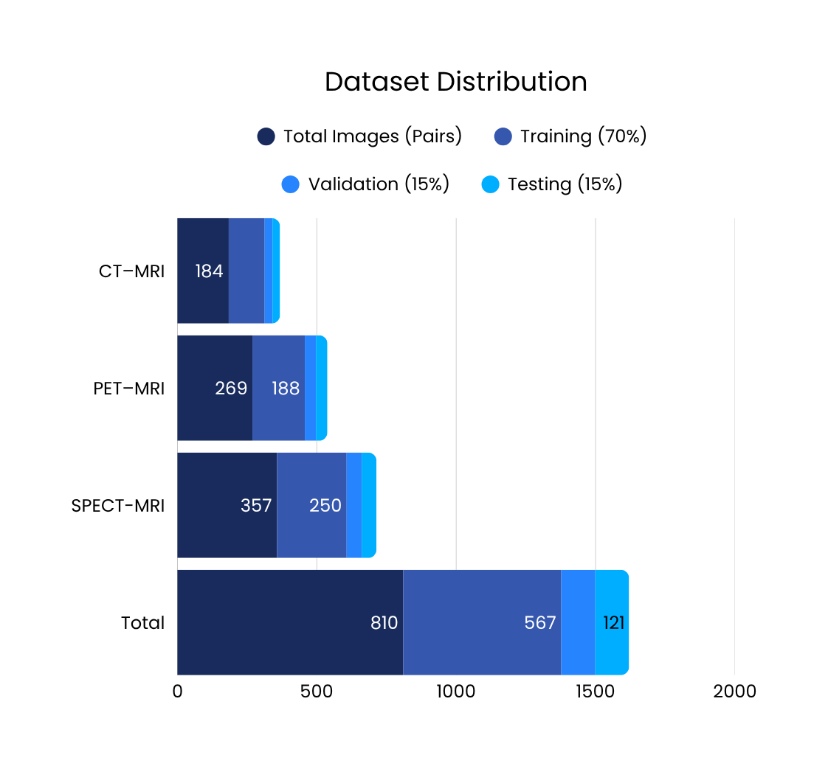
Dataset Used
Harvard Medical Image Fusion Dataset (Kaggle) https://www.kaggle.com/datasets/noamaanabdulazeem/havard-medical-image-fusion-datasets
Contains multimodal pairs: CT–MRI, PET–MRI, SPECT–MRI.
Used widely in fusion research, including PLOS ONE 2024 ensemble model paper.
Preprocessing steps:
Registration (alignment), Normalization, Resizing (256×256), Augmentation.

Slide 7


MODEL OVERVIEW
MODEL ARCHITECTURE
Objective: Develop a deep learning architecture for CT–MRI fusion.
Base Model: U-Net with encoder–decoder and skip connections.
Enhancements:
Attention modules for adaptive feature weighting.
Multi-objective loss (L1 + SSIM + Gradient) for balance of structure and texture.
Output: Single fused image preserving both anatomical and functional information.
U-Net + Attention Overview:
Encoder: Extracts hierarchical features from CT and MRI.
Attention block: Highlights clinically relevant regions.
Decoder: Merges and reconstructs fused output with fine-grained detail.
Loss function: Balances pixel accuracy and structural similarity.

Slide 8
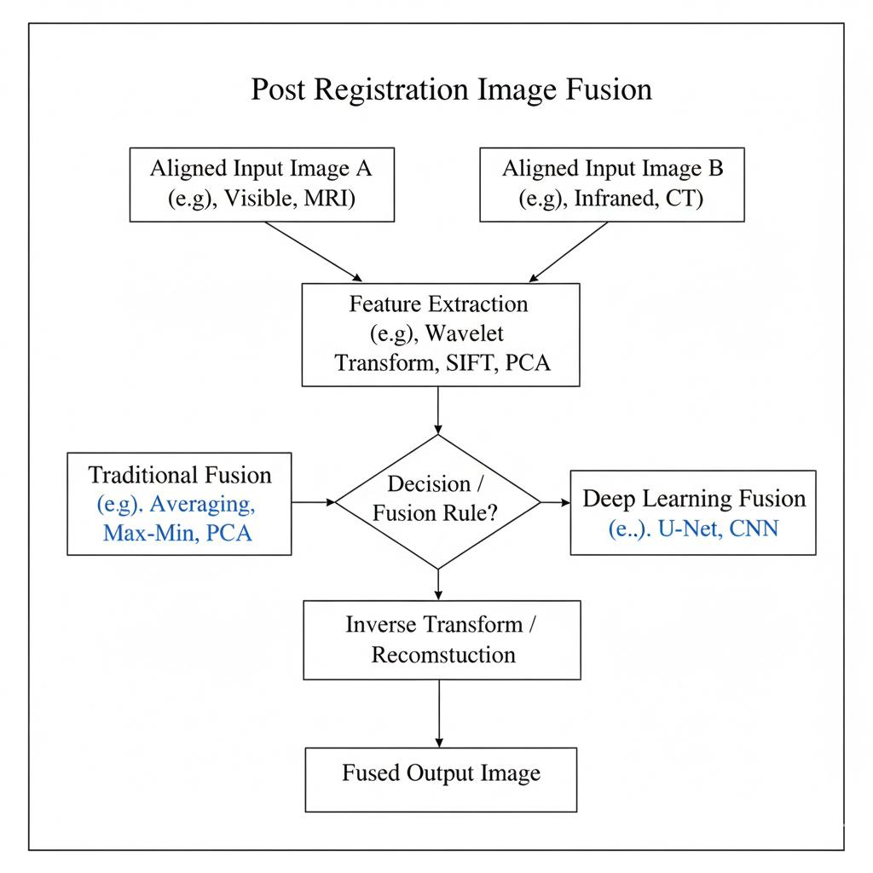
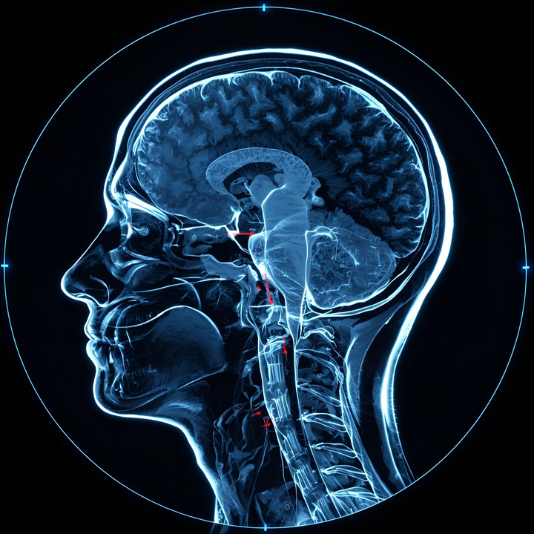
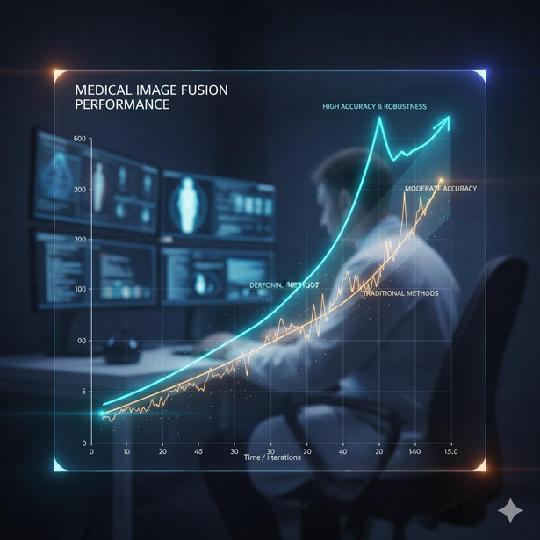
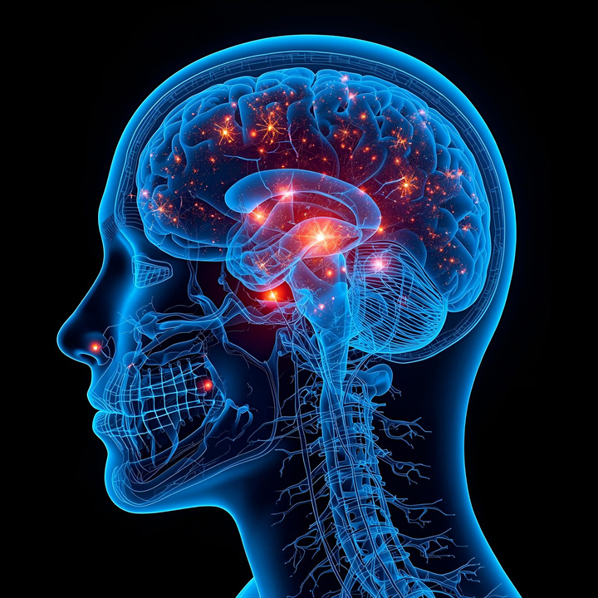
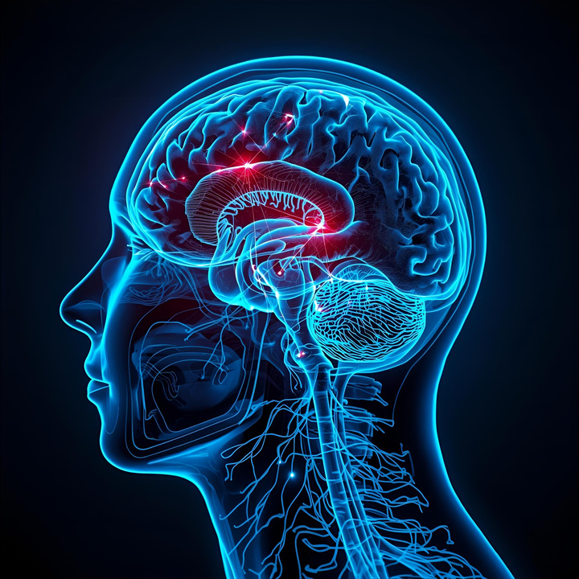
Fusion Pipeline Flowchart

Slide 9
Unique Approach & Innovations
Introduces attention-enhanced U-Net for dynamic feature selection.
Multi-component loss ensures both global context and edge precision.
Adaptive weighting mechanism for modality contribution (CT vs MRI).
Evaluation pipeline includes quantitative metrics + visual analysis for credibility.
Simpler, end-to-end architecture compared to ensemble models (e.g., PLOS ONE 2024).

Slide 10
Current Progress
Completed data preprocessing and model training.
Successful fusion of CT–MRI pairs with sharp structural and textural integrity.
Visual and metric-based validation conducted.
Comparative analysis with PLOS ONE ensemble model ongoing.

Slide 11
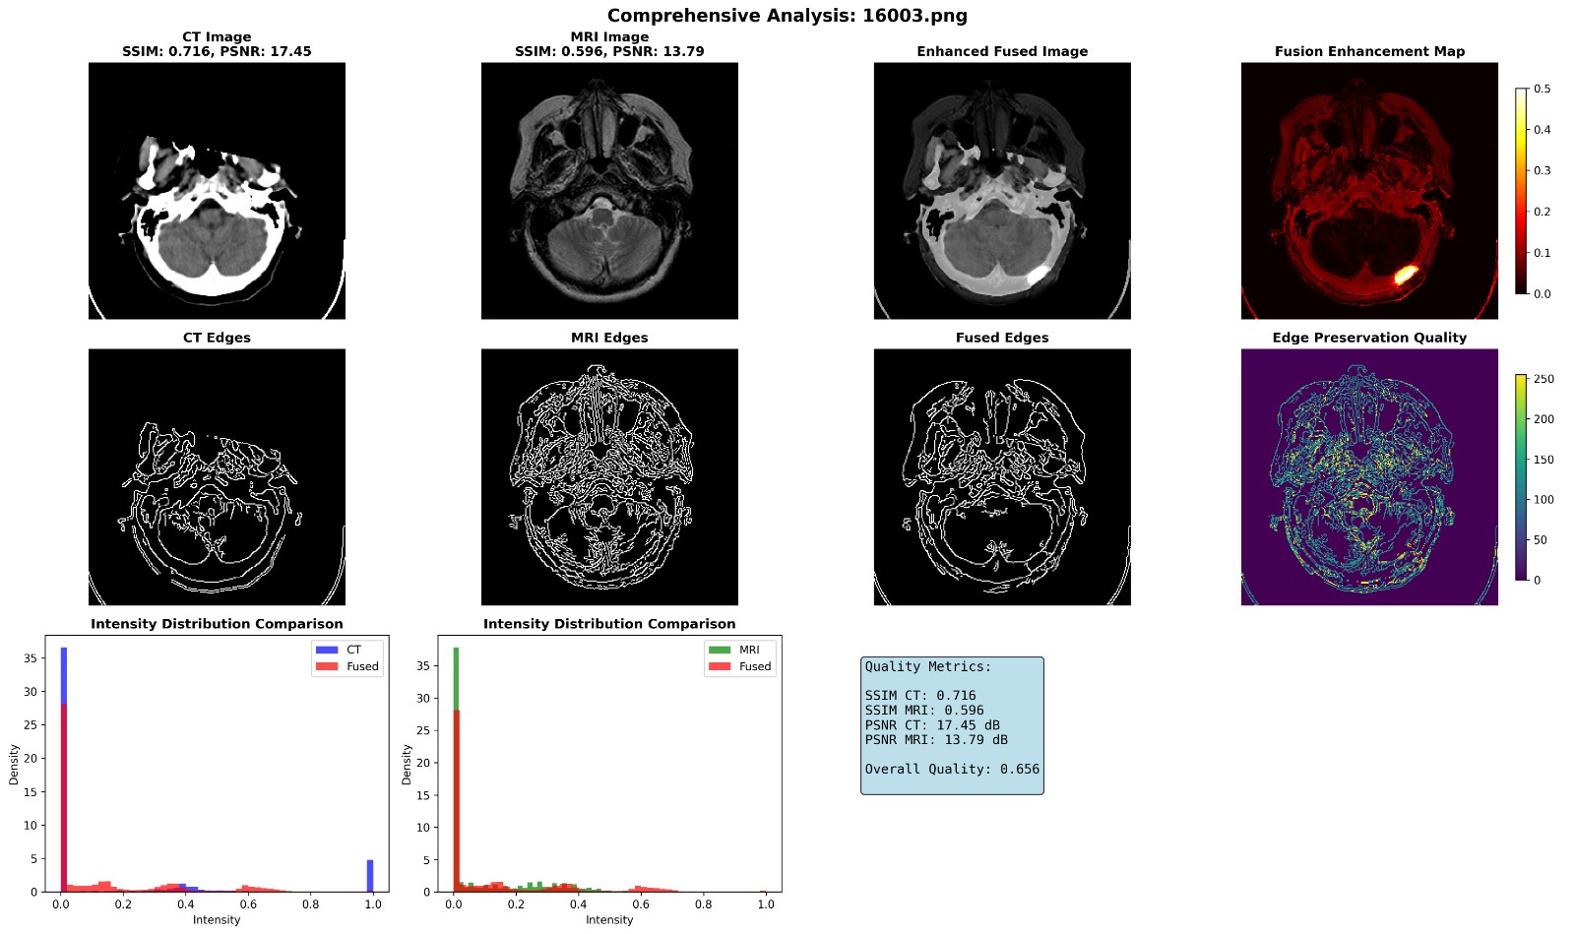
Comprehensive analysis

Slide 12
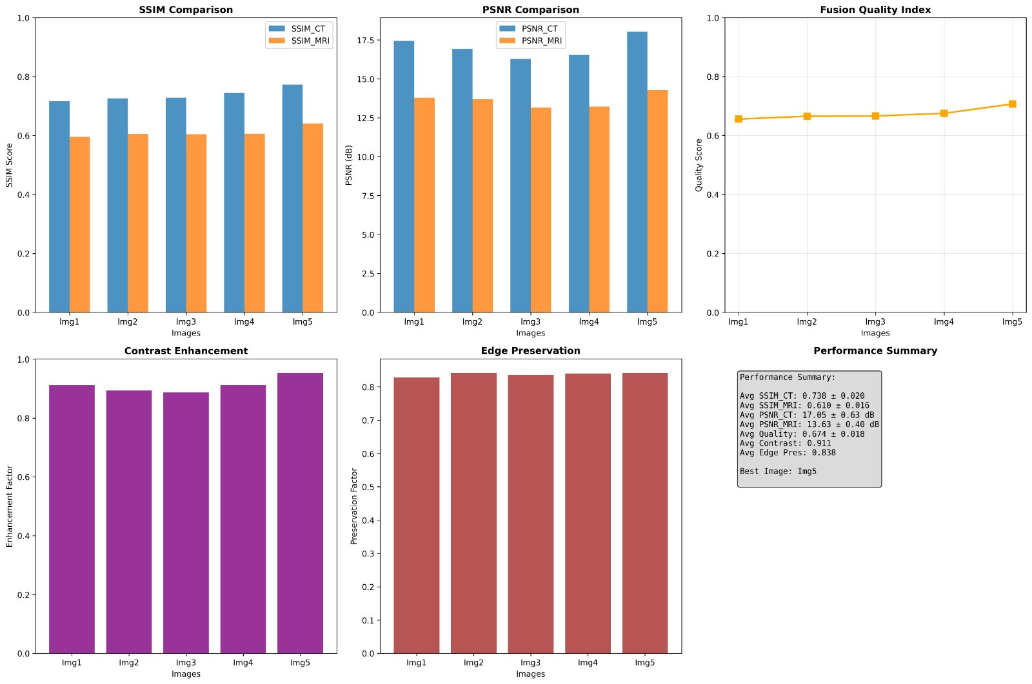
Evaluation & Metrics

Slide 13
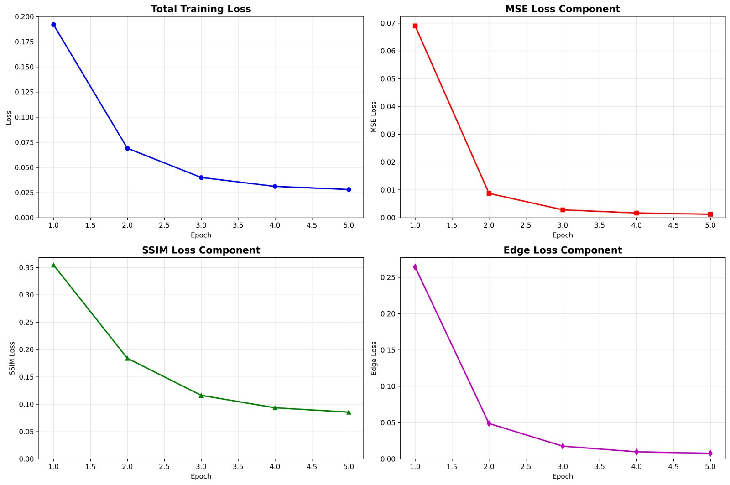
LOSS metrics

Slide 14
Challenges Faced
Dataset alignment issues across modalities.
Balancing detail preservation vs smoothness.
Computational constraints (GPU memory).
Metric interpretability for clinical relevance.

Slide 15
Future Work & Impact
Integrate Transformer-based fusion or Vision Attention models.
Expand to 3D volumetric fusion for MRI/CT slices.
Validate with clinical professionals for real-world application.
Develop fusion + segmentation pipelines for disease localization.
Potential to reduce radiologist workload and improve diagnostic confidence.

Slide 16

references
link | journal name | year | focus area of paper
https://doi.org/10.1016/j.inffus.2020.02.001 | Information Fusion | 2020 | Comprehensive survey of DL-based fusion
https://www.sciencedirect.com/science/article/abs/pii/S0010482523004249 | Computers in Biology and Medicine | 2023 | Covers both spatial/transform domain, end-to-end/non-end-to-end fusion
https://www.nature.com/articles/s41598-024-58665-9 | Scientific Reports | 2024 | Novel pre-trained CNN approach, transform domain focus
https://journals.plos.org/plosone/article?id=10.1371%2Fjournal.pone.0309651 | PLOS ONE | 2024 | Hybrid stacking, multi-input & attention fusion
https://www.nature.com/articles/s41598-025-93616-y | Scientific Reports | 2025 | Multi-path feature disentangling, transformer-based fusion

Slide 17
OPEN FOR QUESTIONS AND ANSWERS
THANK YOU

